Slide 1
History of AI Methods
March 16th, 2024

Slide 2
A history of ML and AI, methods and mistakes
AI History
Dreams of “Robots”, Servant and Other
The dawn of computation
The first neural network
Humans have always been fascinated with the idea of ”automatons”
The last century has marked the departure from our imagination to attempts at application.
We’ll go over the basics of the machine learning space, and begin to answer the question of how far our reality is from the science fiction of yesteryear.
The Heuristic Red Herring
The first Machine Learning Explosion
ML Methods
How computers “know” the world- Vectorization
“Supervised” vs. ”Unsupervised”
What’s an Ensemble Model anyway?
Transformers, the latest big boom
AI today
The second machine learning explosion
LLMs, lots of transformers, lots of data
What does. The future hold?

Slide 3
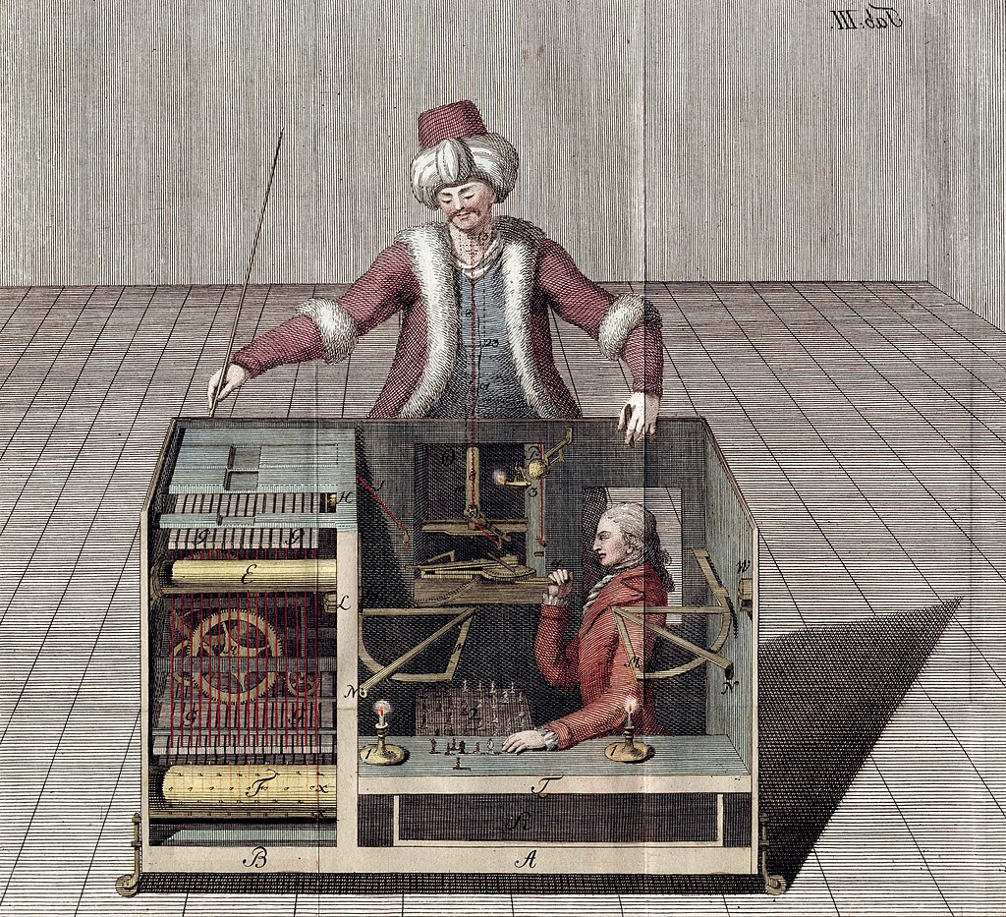
Dreams of “Robots”, Servant and Other
555 BC- 1946 AD
Notes:
Humans have had myths of Artificial life from the beginning. Golems animated by magic or faith, metal pidgeons flying by steam and gears, all of these are from our earliest myths across cultures. The fascination is something core to humanity, and was thought to be what would end the practice of slavery.
But the closest reality got to the legends were cons, puppets pretending to be autonomous.
These stories would be Satirized in a Czech play, that would reduce the magical automata into some thing more cynical, Robota, Czech for “Labor,” in 1923

Slide 4
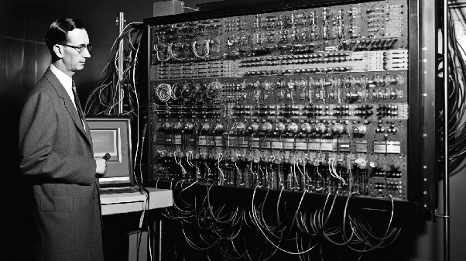
The Dawn of Computation
1946- 1957
Notes:
The first computer was invented in 1945, revealed in 1946, computers would enable far easier and immediate computation of hypothetical mathematic models of conscious thought.
The mathematical groundwork for neural networks we have today would come a decade later.

Slide 5
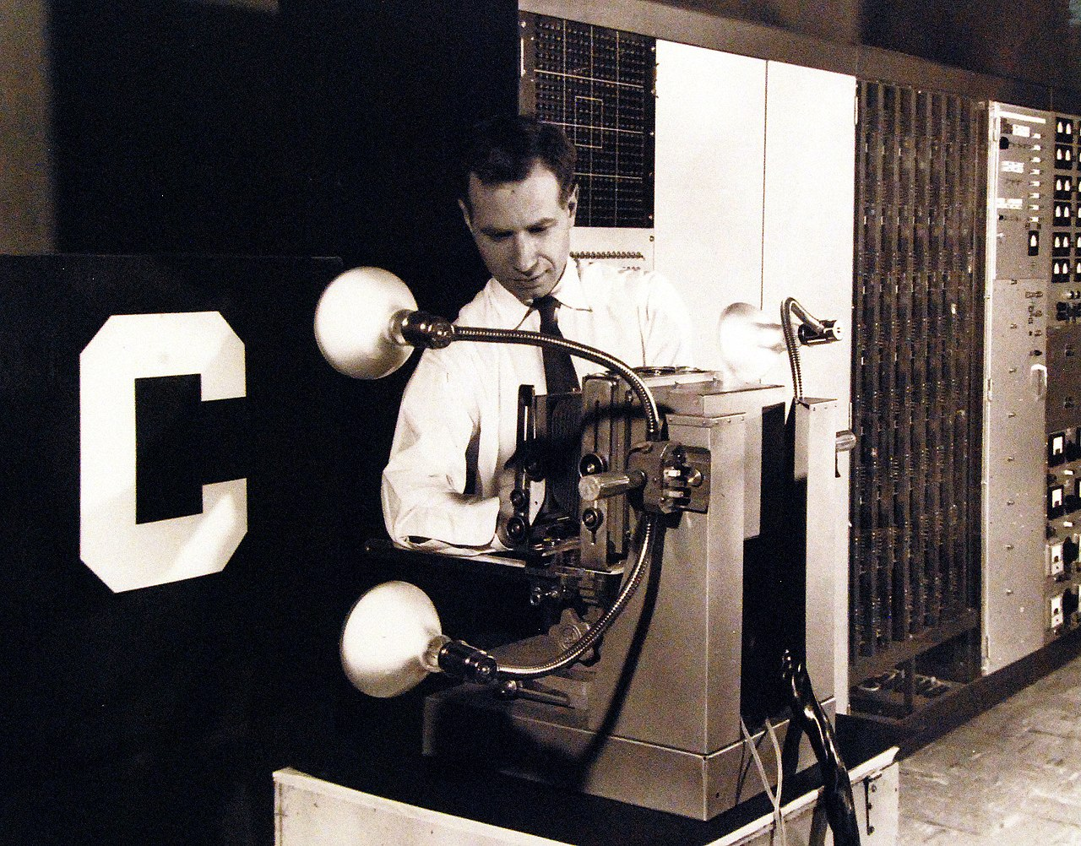
The First Neural Networks
1951-
1959
Notes:
SNARC, was developed by Marvin Minsky in 1951, and would use reinforcement learning to proceed through a maze, but could only hold limited memory and wasn’t “trainable.”
The first trainable neural network was made after a decade of theory in 1957, by psychologist Franken Rosenblatt, and would set off a sequence of experiments involving training weights over a single layer of perceptron's using data like the Cornell C.

Slide 6
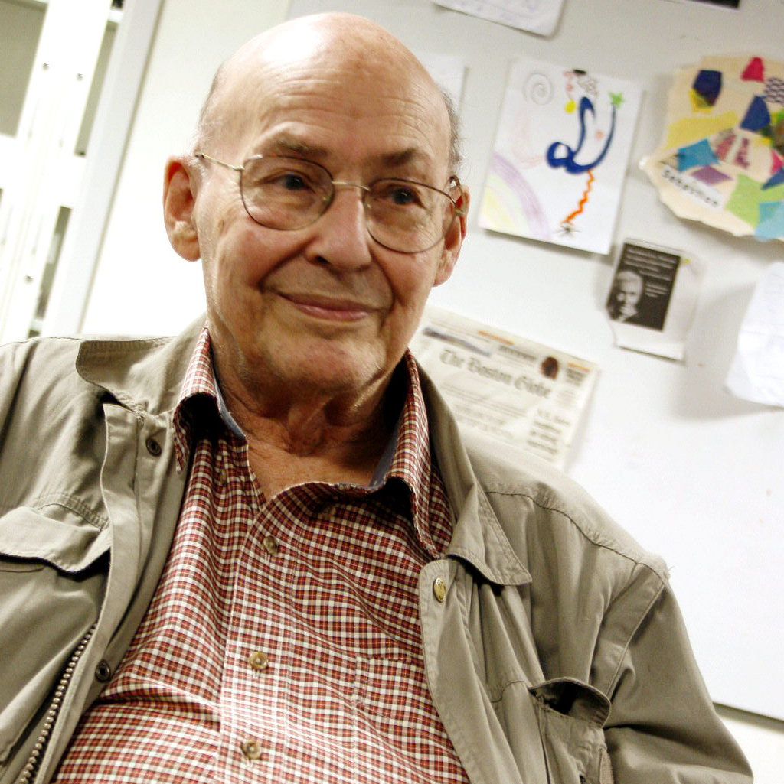
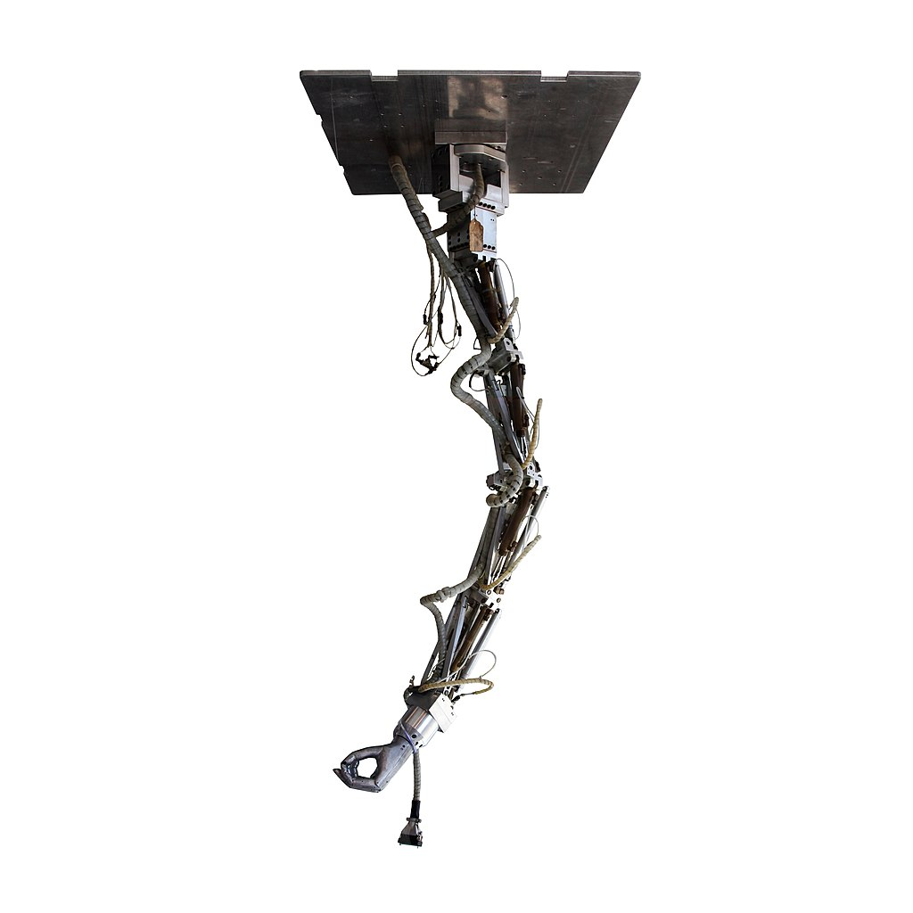
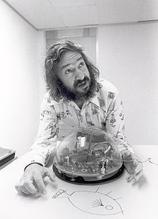
The Heuristic Red Herring and AI Winter
1959-
1985 (Roughly)
Notes:
In 1959, mathematicians Marvin Minsky and Seymour Papert would publish a book called “Perceptron's” that demonstrated that they would be impractically computationally intensive. Research on neural networks was more or less quashed, as Minsky and Papert would found the AI department at MIT based on Heuristic research built around the society of mind theory, being that a mind was composed of multiple mechanical non-sentient parts.

Slide 7


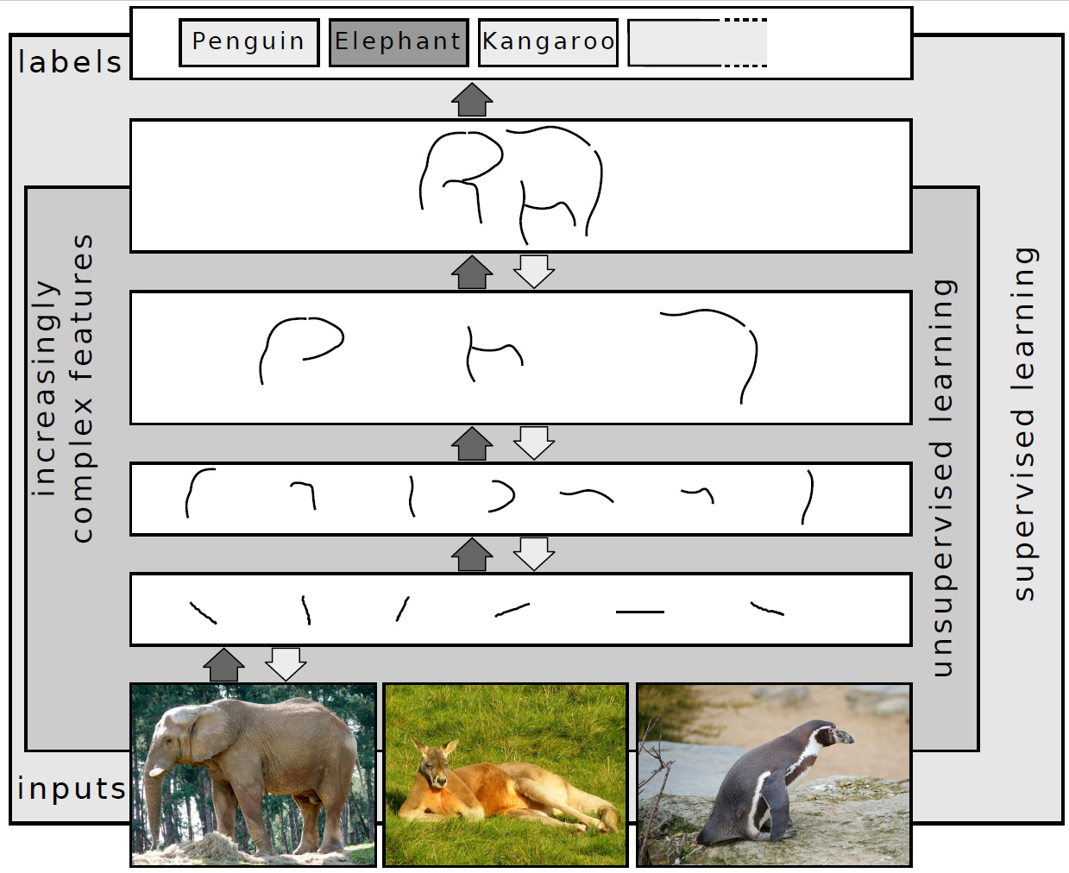
The First ML Boom
1985- 2017
Notes:
The combination of an increase in computational power combined with the advent of deep learning would create a massive shift from 1990s into the 2000s. Powerful deep learning networks were not only outperforming heuristic models, but best of humanity within their subjects of expertise. The goals of AI since then have shifted, from “Intelligence” and utility, to “General Intelligence.”

Slide 8
ML Methods
ML Methods
How computers “know” the world- Vectorization
“Supervised” vs. ”Unsupervised”
During this first Machine Learning boom, Data Scientists and ML engineers have been using a variety of methods to process data and train ensemble models that are considered underneath this big umbrella of ML, due to these models ability to “learn” from data.
This is considered apart of AI as we have, up until recently, considered learning a distinctly human quality.
We’ll be going over the most basic here and in the upcoming exercise.
What’s an Ensemble Model anyway?
Transformers, the latest big boom

Slide 9
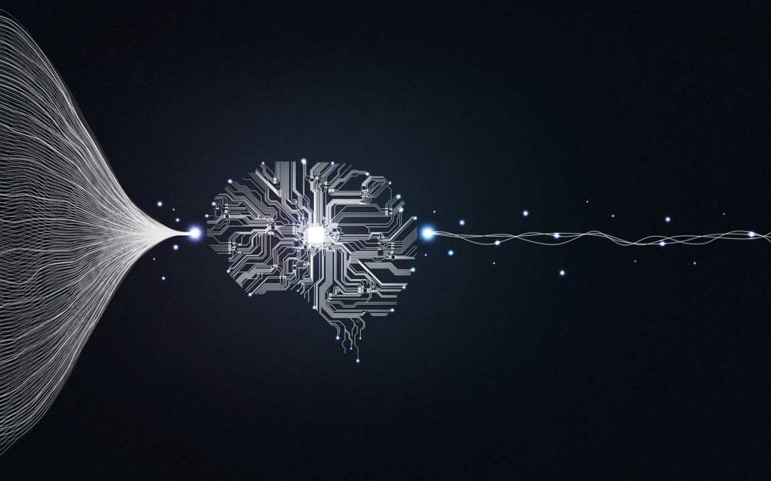
How can a computer understand the world?
Notes:
Computers, at their foundation, still operate as advanced computation machines. The equations may become infinitely more complex as we develop more intricate and powerful processors, but their cognition needs to function numerically at a fundamental level.
It’s worth the context that this similar framing could be applied to chemical synapses in the human brain.
We call the process we use to turn sensory information from the real world into tangible numbers that can be compute “Vectorization,” and this is arguably where the greatest advances in AI have been in recent years.

Slide 10
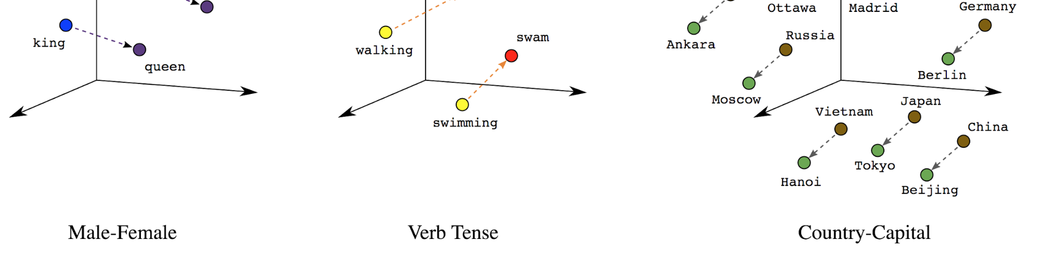
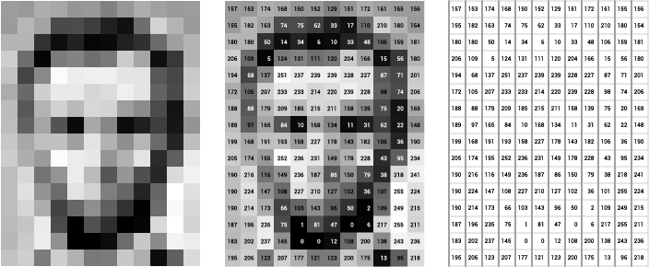
Two fields of vectorization, text and visual
Notes:
Generally, we talk about vectorization when the data is not immediately represented numerically or categorically, i.e. waveforms.
So typically, the way we vectorize varies from text to images, each of which have a different family of methods attempting to convey information about each element of the larger wholes with data.
Today, vectorization itself is also achieved by model trained to convey as much detail about each word and pixel as possible using the entire internet as a training corpus.

Slide 11
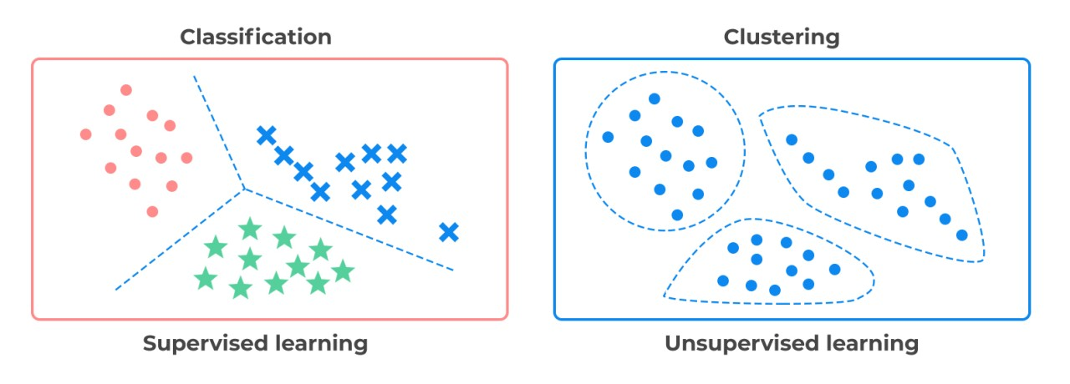
Unsupervised vs. Supervised
Notes:
Although deep learning has muddied the waters on this a bit, most machine learning approaches are divided into “supervised” applications, in which the data is labeled and there is a known pattern that the ML model is attempting to emulate, and unsupervised models which attempt to find patterns within unlabeled data.
Knowing the context of the application and the nature of your data allows you to make this critical decision when assembling your first ML models on a dataset.

Slide 12
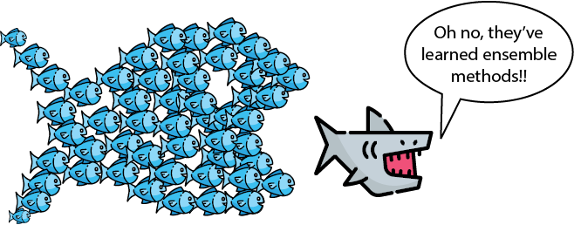
What is an ensemble model anyways?
Notes:
Put simply, an ensemble model is a crowd of models who collectively choose a prediction out of many.
Many models today are not singular structures, nor do they come up with just one conclusion internally, before selecting the most likely answer from the possibilities.
Many Ensemble models are often called “black box,” in the sense that the process they use to come to particular conclusions is not as clear as the overall mechanism of their function on a theoretical level.

Slide 13
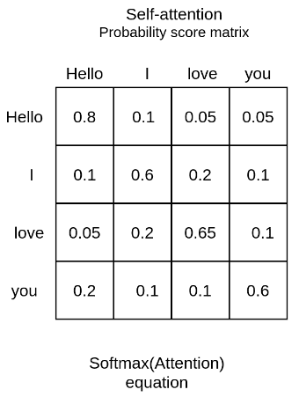
Transformers, the kickoff of the “second” ML boom.
Notes:
We will go into much more detail into transformers in a later lecture “How AI actually works, this will just be a brief overview of what this changes.”
Transformers, as they’ve evolved since 2017, have more or less vectorized the English language, using positional encoding to encode nuanced relationships in billions of patterns of words.

Slide 14
AI Today
2017-???
AI today
The second machine learning explosion
LLMs, lots of transformers, lots of data
What does. The future hold?
The recent developments in AI are likely why most of you are here today.
The large scale implementation of transformer architecture has created models called “Generative AI” which create new patterns of words and video that iterate and arguably fit in with the whole of our creative legacy.
Where will this all lead?

Slide 15
The release of the largest transformer model at the time, GPT-3, massively increased public attention and funding.

Slide 16
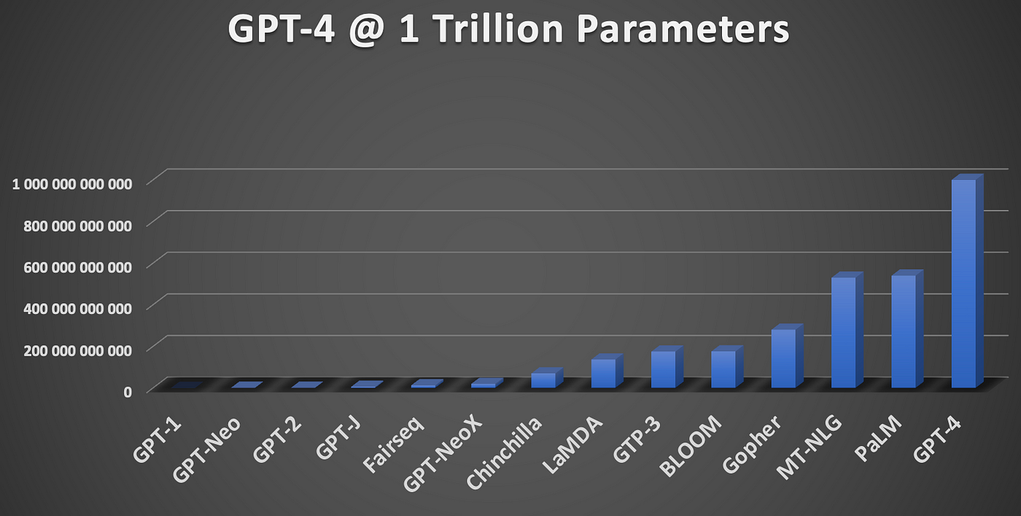
Large Language Models, lots of data, lots of parameters
Notes:
You may hear about the scale touted by LLMs, and this is essentially what delineates them from the transformer models we talked about in 2017. A large language model is what it sounds like, a large model of our language in the format of billions of parameters.

Slide 17
What does this mean for the future?
Notes:
Many media personalities (and some AI startups) like to mystify AI, much like the stories we talked about of magical golems turning against their masters or delivering humanity.
AI is powerful, but it is understandable. That said, we need to understand its implications for us as we create the “Robots” that do the labor we’ve defined ourselves up to this point.
It may be that what we need to develop a better understanding of is not AI, but the value of humans without the intelligence to compete with AI, which may quickly be all of us.

